Slide 1

Wildfires Creating Awareness & Igniting Action
Team: Supriya Vadakkeveetil
Jesse Reeves
Aditya Saini

Slide 2
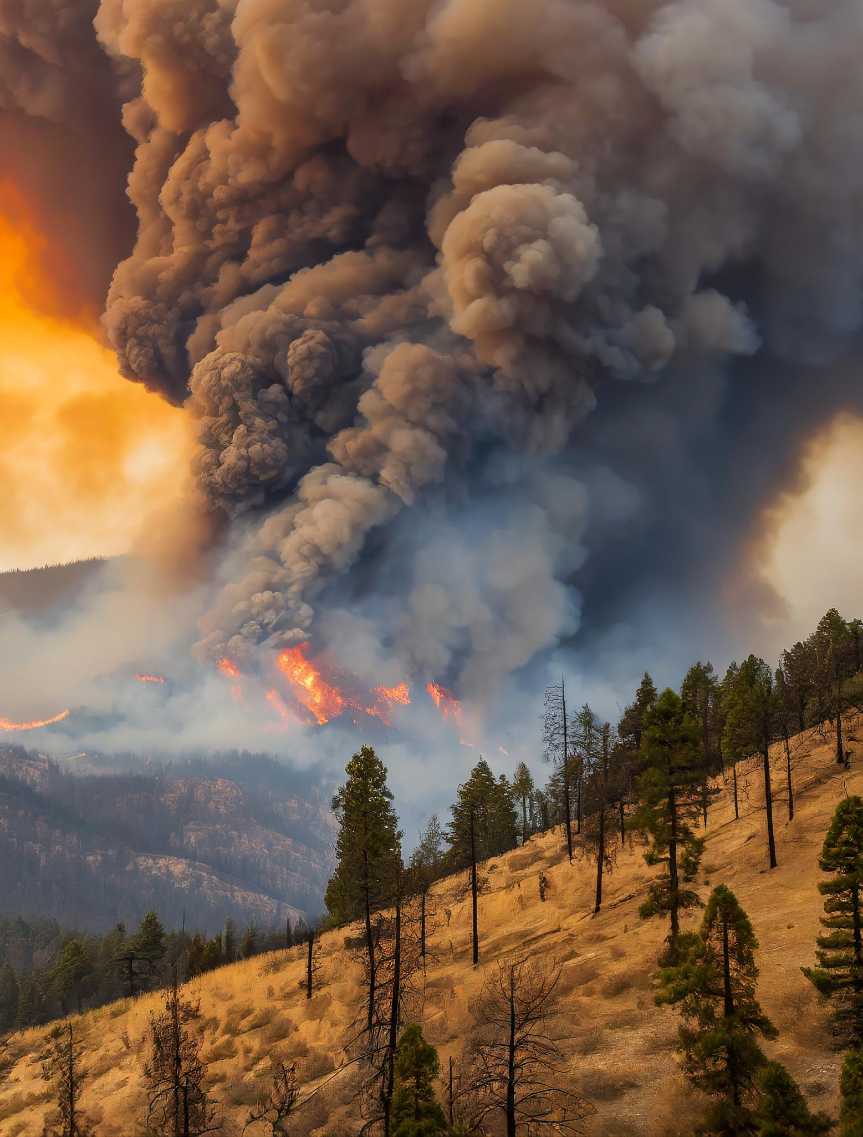
Wildfires
Wildfires constitute a formidable threat to our landscapes and its impact reverberates across multiple dimensions.
Flora and fauna
Influence on air quality affecting the health and well-being of both human and animal life.
The repercussions extend beyond the immediate timeframe, leaving enduring impacts that resonate across ecosystems, communities, and the broader environment.
Notes:
Causes of Wildfire
Lightning Strikes – Natural Cause
Human Cause –Power companies(downed power lines due to bad weather), Equipment mishap, unattended fires, arson

Slide 3
Who the Project will benefit
Stakeholders(Local Governments, Real estate etc.)
Researchers and
Public
To comprehend the frequency, geographic distribution, causes, and impacts of wildfires.

Slide 4
Data Visualization

Slide 5
Data Discovery
Data Sources
US Department of Agriculture
CA.gov
Data
Wildfire data for United States (Period 1992-2020)
Fire Hazard Severity Zones data
Wildland Fire Facilities data

Slide 6


Data Cleaning & Storage
Converting data from Shapefile, SQLite files to GeoJSON and CSV format
1
Filtering the necessary data
2
Removing Null values
3
Storing data in MongoDB
4

Slide 7
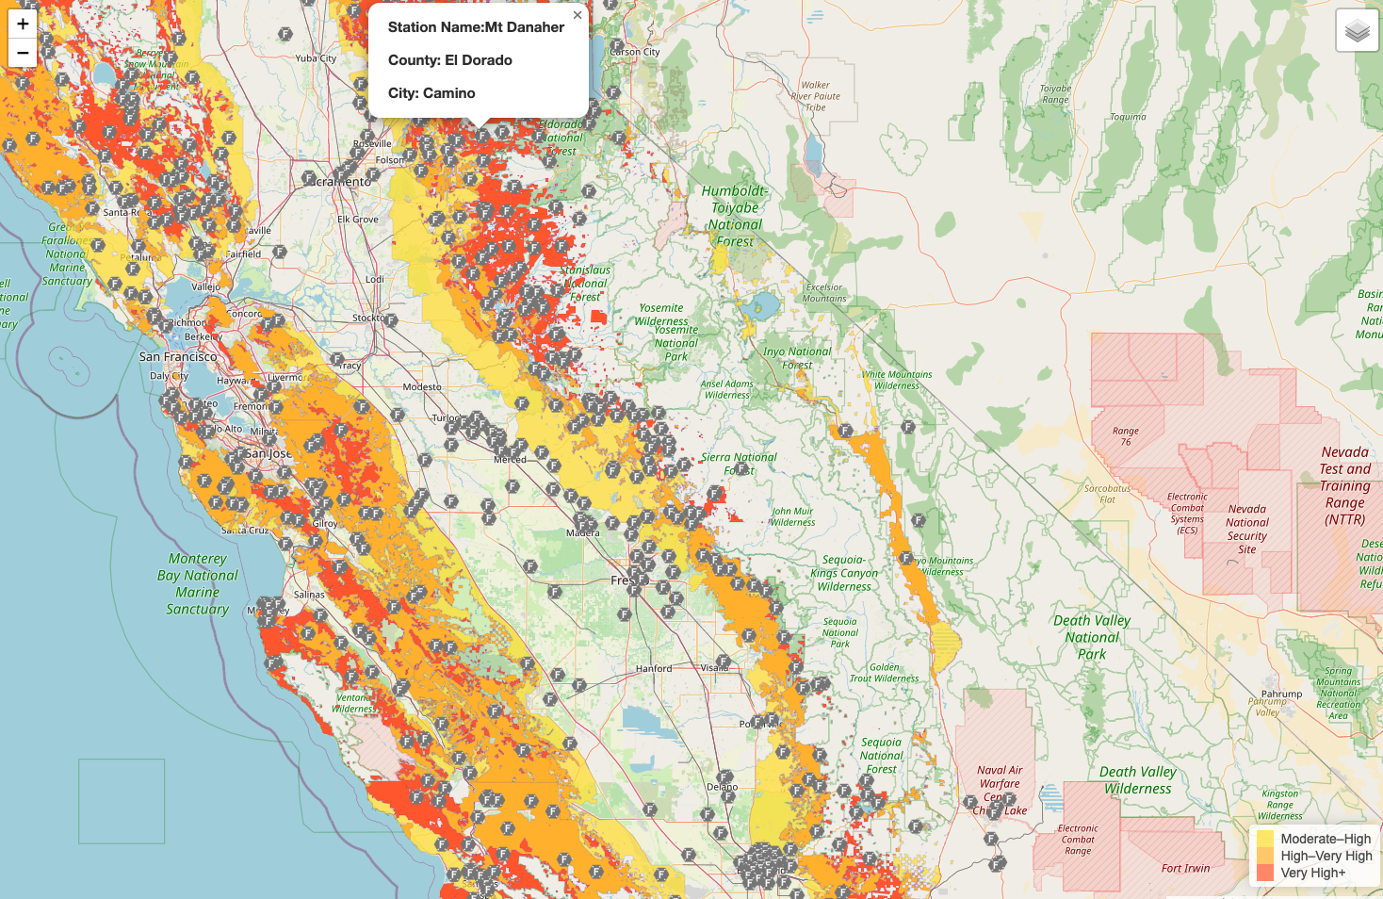
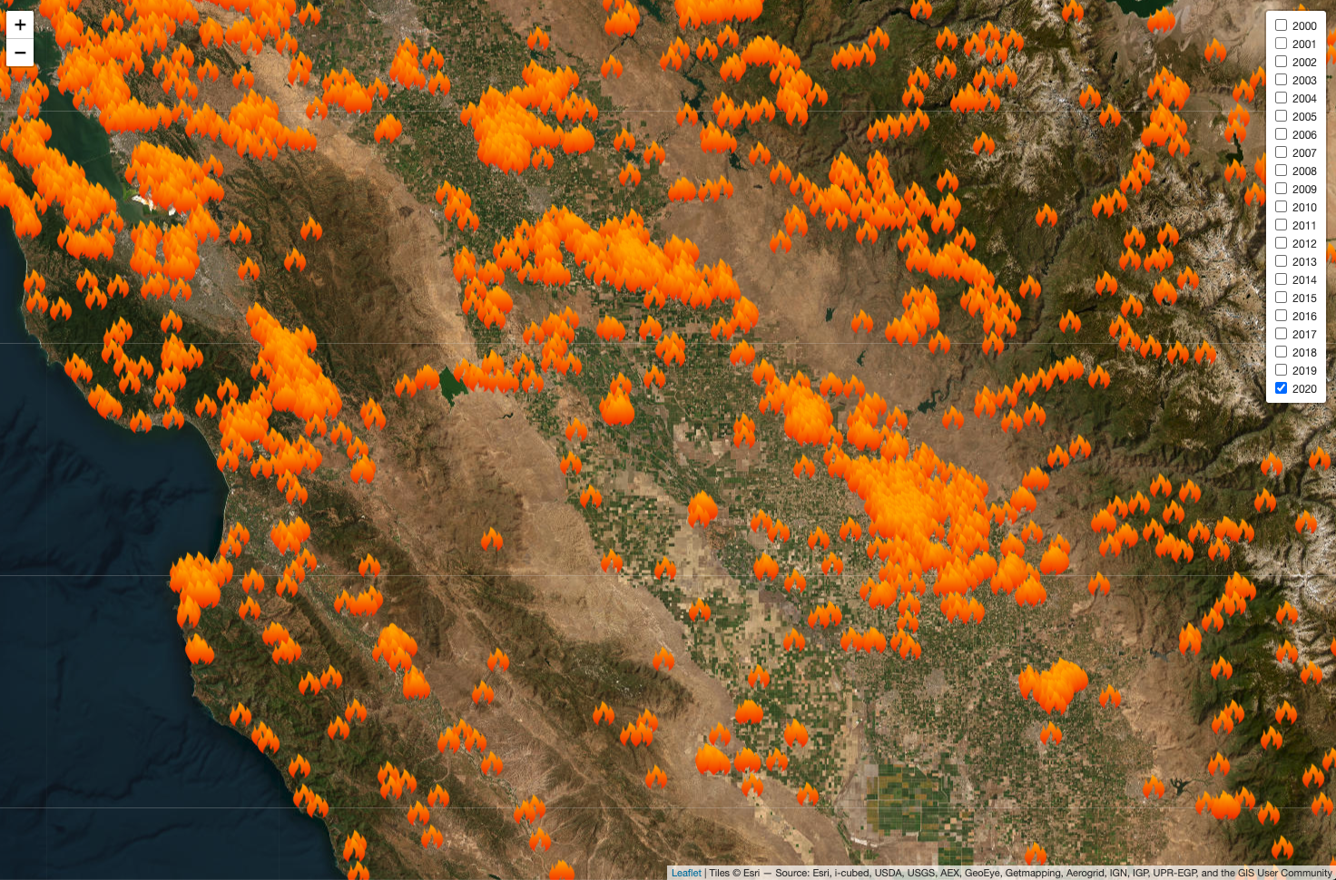
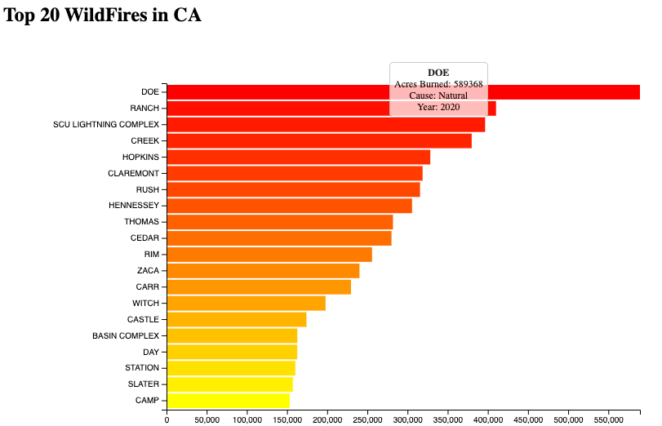


Data Visualization

Slide 8
Wildfire Visualization Demo

Slide 9

Ethical Considerations
Data Privacy & Security
Educational Purpose
Notes:
data privacy and security- measures have been implemented to guarantee that no sensitive information is utilized
explicit purpose of our project — education. The data employed in our class project is sourced exclusively from reputable government websites that explicitly permit its use for educational analysis.
Every effort has been made to ensure the accuracy of the data, representation and visualization of the information.

Slide 10
Thank You

